Slide 1
System Analysis and Design

Slide 2
AirLine Project
project requirements:
PROCESS MODELING
04)Database
Design
03)Entity relationship
02)DFD
01)Usecase

Slide 3
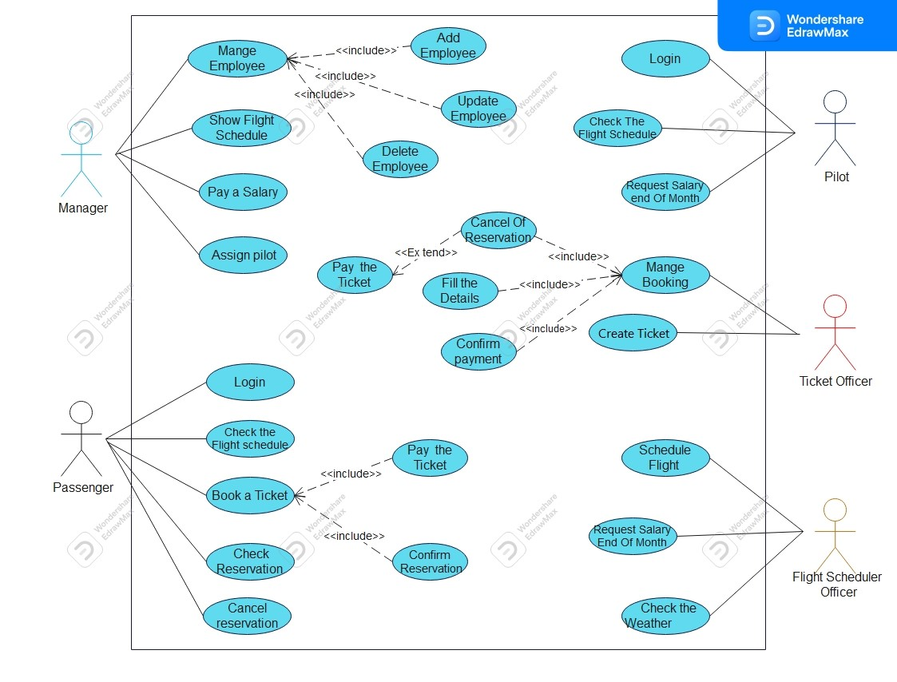
AIRLINE SYSTEM
usecase

Slide 4
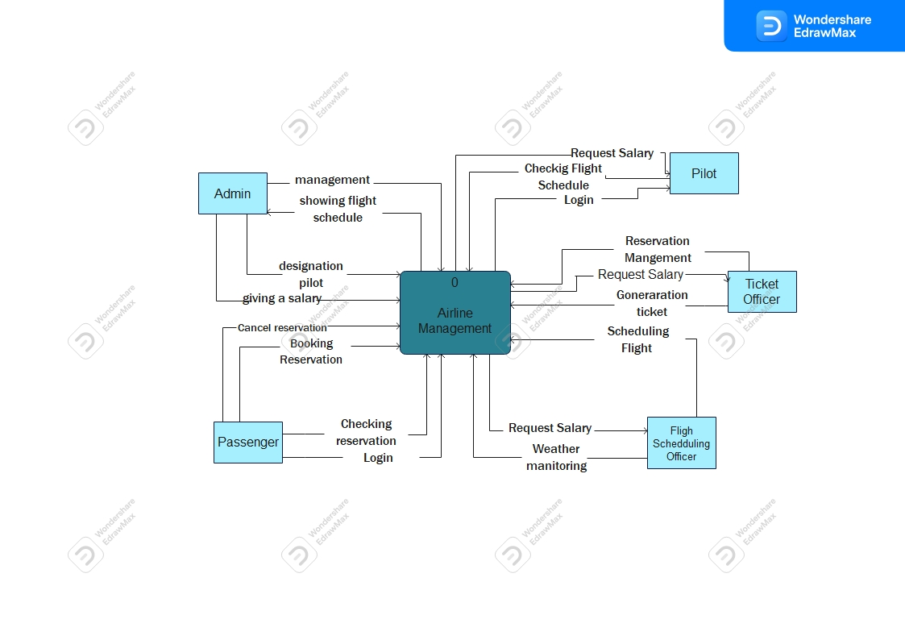
DFD
LEVEL ZERO

Slide 5
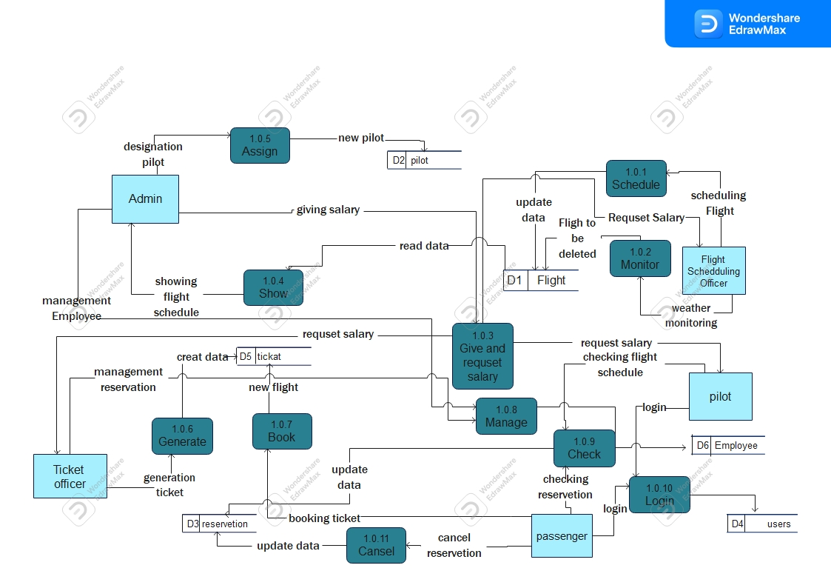
DFD
LEVEL 1

Slide 6
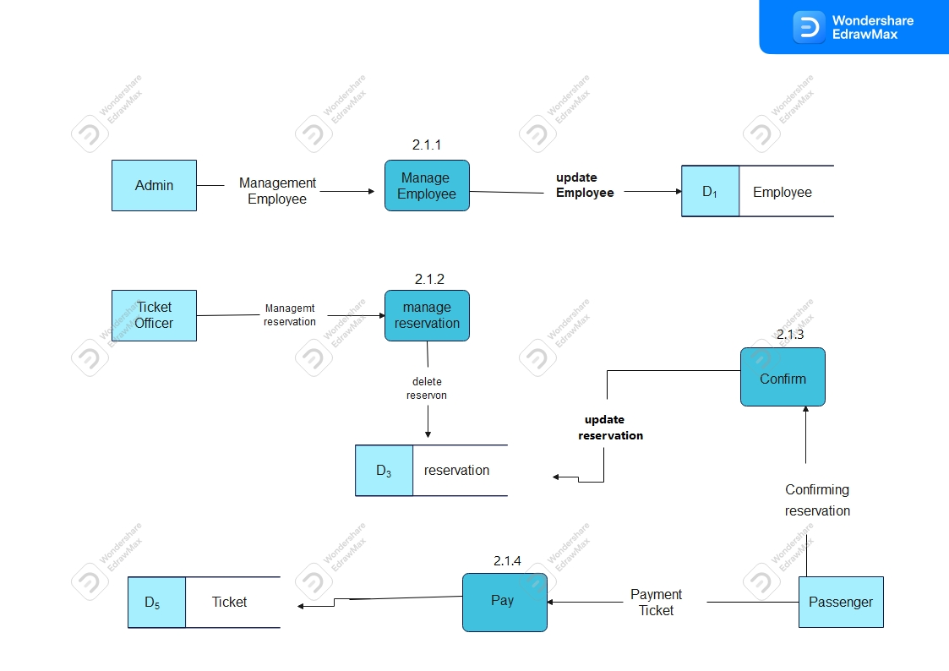
DFD
LEVEL 2
6

Slide 7
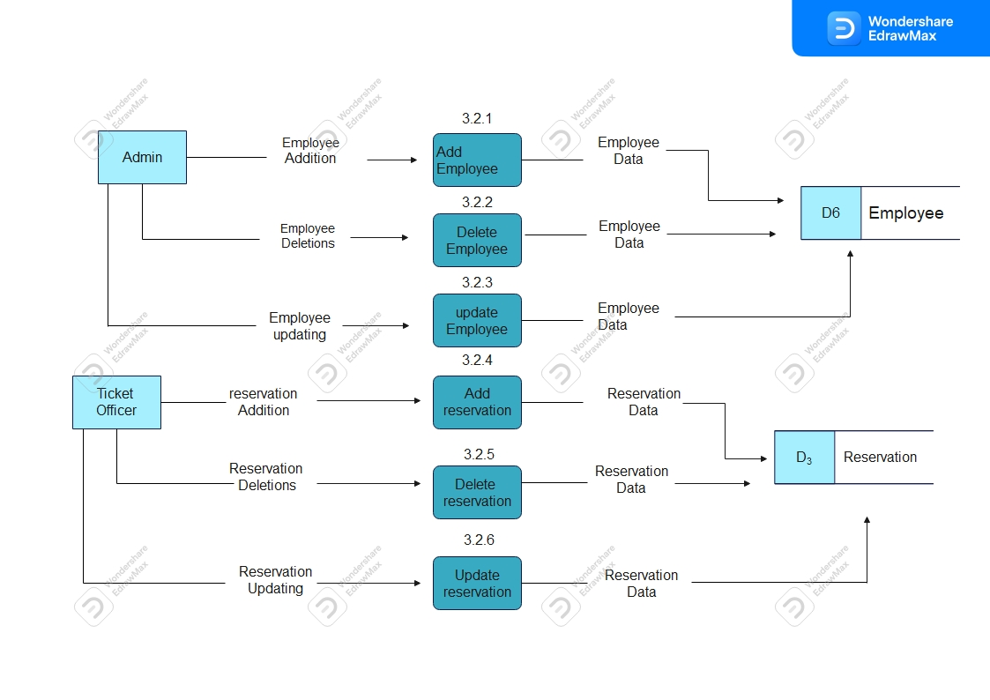
DFD
LEVEL 3

Slide 8
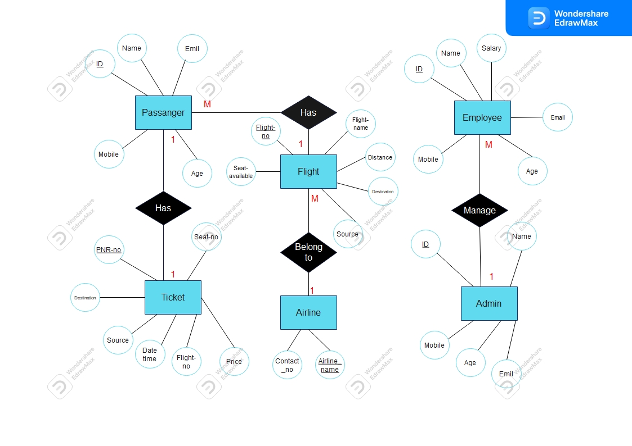
ERD

Slide 9
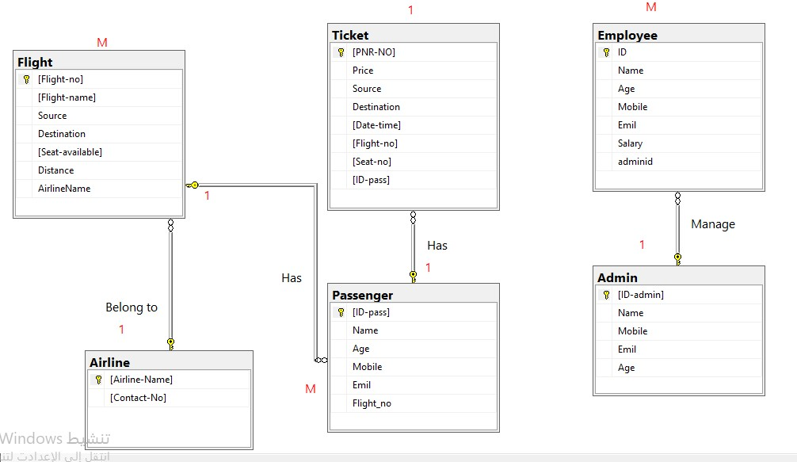
Database Design

Slide 10
Names of the project students:
afnan alafif
rawan suwaidan
hafsa salah
alaa alawadi
fatma ben ali alhajj
AirLine

